Slide 1
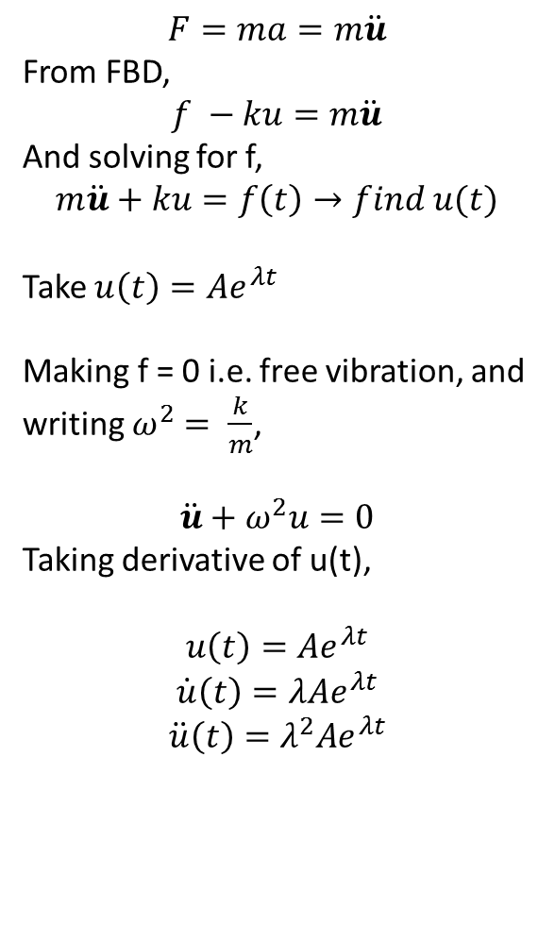
Michael R. Justice
1/19/15
SDOF Oscillator (viscous damping)
$$F=ma=m\ddot{u}$$
From FBD,
$$f −ku=m\ddot{u}$$
And solving for f,
$$m\ddot{u}+ku=f\left(t\right)→find u(t)$$
Take $u\left(t\right)=Ae^{λt}$
Making f = 0 i.e. free vibration, and writing $ω^{2}= \frac{k}{m}$,
$$\ddot{u}+ω^{2}u=0$$
Taking derivative of u(t),
$$u\left(t\right)=Ae^{λt}$$
$$\dot{u}\left(t\right)=λAe^{λt}$$
$$\ddot{u}\left(t\right)=λ^{2}Ae^{λt}$$

